Slide 1
Rate-Independent Constructs for Chemical Computation
Phillip Senum
University of Minnesota

Slide 2
Motivation
Much effort has been spent developing techniques for analyzing existing chemical systems.
Comparatively little has been devoted to designing chemical systems.
Seek to demonstrate that chemical systems can compute mathematical and logical functions.
Notes:
Minimize time here
Not to compete with computers for number crunching – build embedded controllers (drug delivery, etc.)

Slide 3
Abstract/Conceptual Designs
Microprocessors:
  Physical implementation with transistors.
  Theoretical implementation with logic gates.
We can apply a similar level of abstraction to the design of biochemical system:
  Physical implementation with chemical reactions.
  Theoretical implementation using “modules.”
Notes:
Minimize time here

Slide 4
TIMES TWO
12
6

Slide 5
TIMES TWO
90
45

Slide 6
TIMES TWO
Notes:
Exact and rate-independent

Slide 7
TIMES TWO
Notes:
Feature of synchronization

Slide 8
Design Objectives
Minimal number of chemical reactions.
Coarse rate categories:
  “Fast”
  “Slow”
Each module has its own enable signal
(and so is synchronizable).
Results are exact.
Notes:
Rates: separated by orders of magnitude

Slide 9
Chemical Model
Discrete chemical kinetics:
  “Variables” are molecular types.
Validation via stochastic simulation:
  Gillespie’s method.

Slide 10
Building Blocks
Inversion
Duplication
Incrementation/Decrementation
Comparison

Slide 11
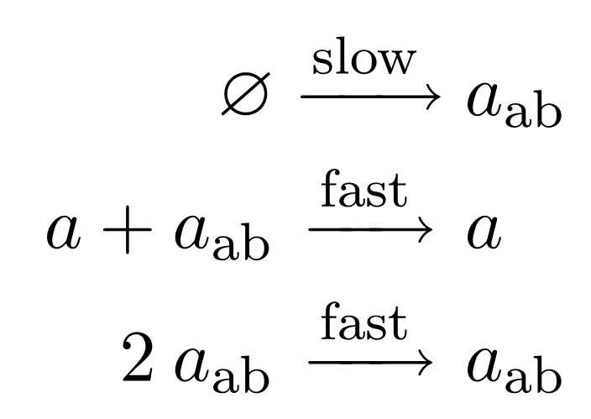
Inversion
Produce a quantity of a species in the absence of another specific species.

Slide 12
Inversion
a
a_{ab}
a_{ab}

Slide 13
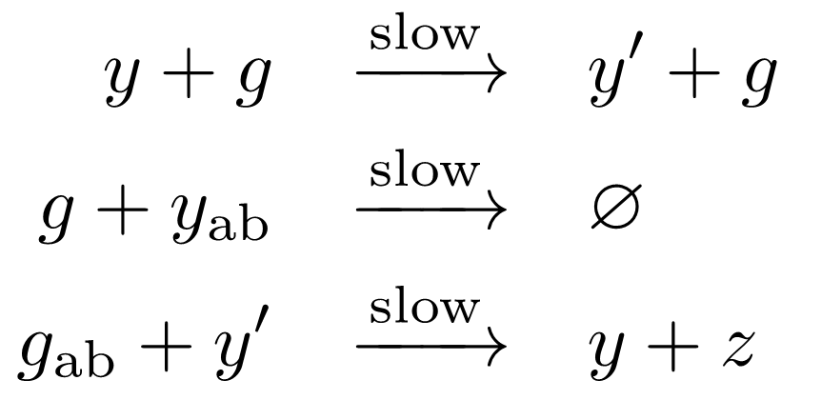
Duplication
Produce a quantity of a new species equal to the original population of the source species without permanently modifying the source.

Slide 14
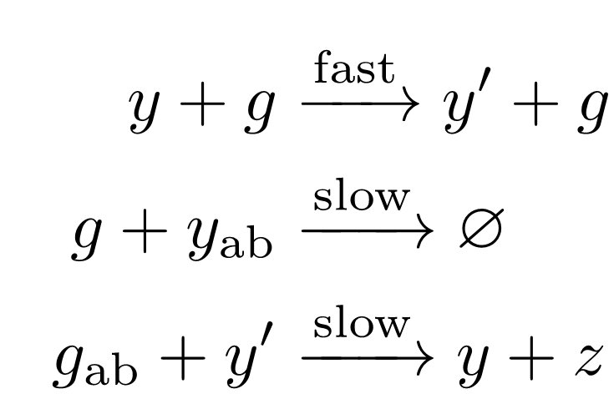
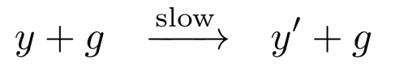
Duplication
g
y’
y
y
z

Slide 15
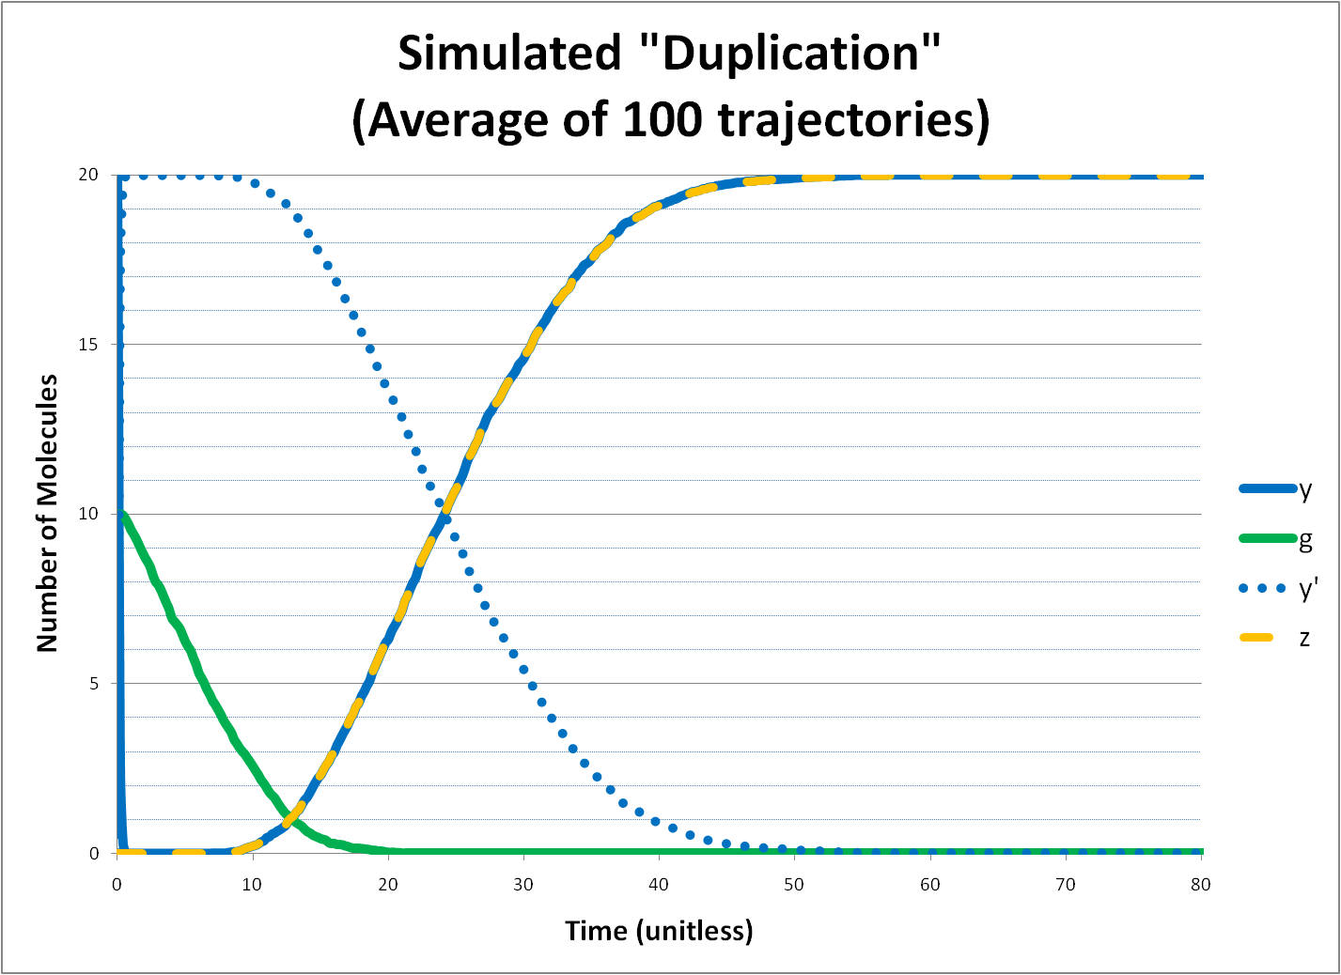
Notes:
FIX ME

Slide 16
Duplication
Trial | Fast : Slow | Trajectories | g | y | z | Expected z | Rel. Error
1 | 100 | 500 | 5 | 100 | 102.45 | 100 | 2.45%
2 | 1000 | 500 | 50 | 100 | 104.826 | 100 | 4.83%
3 | 1000 | 500 | 5 | 100 | 100.312 | 100 | 0.31%
4 | 10000 | 500 | 50 | 100 | 100.516 | 100 | 0.52%
5 | 10000 | 500 | 5 | 100 | 100.022 | 100 | 0.02%
6 | 10000 | 500 | 50 | 100 | 100.034 | 100 | 0.03%
7 | 10000 | 500 | 5 | 5000 | 4938.39 | 5000 | 1.23%
8 | 10000 | 500 | 50 | 5000 | 4967.26 | 5000 | 0.65%
9 | 10000 | 500 | 200 | 5000 | 4796.38 | 5000 | 4.07%
10 | 10000 | 500 | 50 | 2 | 2 | 2 | 0.00%
Notes:
Don’t stumble here

Slide 17
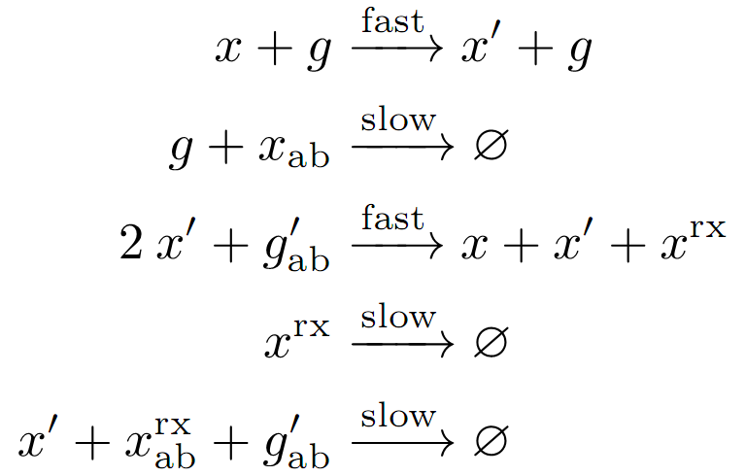
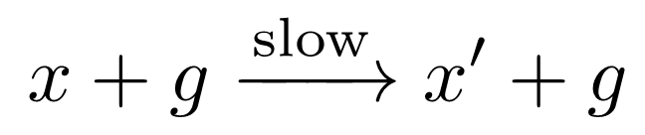
Incrementation/Decrementation
Add or subtract one from the population of a species:

Slide 18
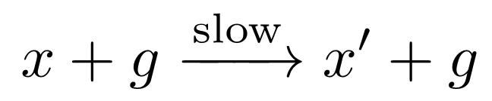
Decrement x
g
x
x’
X₀ = 5

Slide 19
Decrement x
X₀ = 5
x
x^{rx}
x’
x’
x’
x’
x’

Slide 20
Decrement x
X₀ = 5
x^{rx}
x
x^{rx}
x’
x’
x
x’
x’

Slide 21
Decrement x
X₀ = 5
x^{rx}
x^{rx}
x
x^{rx}
x’
x’
x
x
x’

Slide 22
Decrement x
X₀ = 5
x^{rx}
x^{rx}
x^{rx}
x
x^{rx}
x
x’
x
x
x’

Slide 23
Decrement x
X₀ = 5
x^{rx}
x^{rx}
x^{rx}
x^{rx}
x
x
x’
x
x
X_{f} = 4

Slide 25
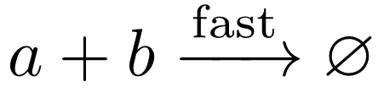
Comparison
Compare the initial quantities of two species and produce a species if the requested condition is true.
Either a or b will remain.
  Presence or absence of each can be used to check if a condition is true.
  E.g. If a and b are initially equal, both will be completely consumed.

Slide 26
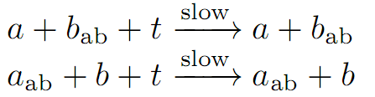

Comparison
a
a
b
b
a
a
a_{ab}
t
b
b
a
a
b_{ab}
b
t
t
a
a
b
b
b

Slide 27
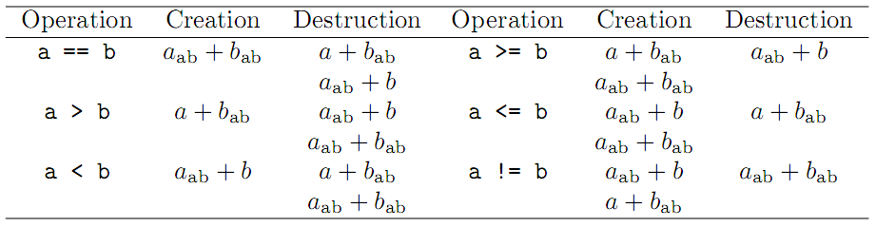
Comparison
Logical comparisons of any type can be performed.

Slide 28
Combining Modules
By cascading modules, we can perform more complex operations:
  Multiplication
  Logarithm
  Exponentiation
  Raise to a Power

Slide 29
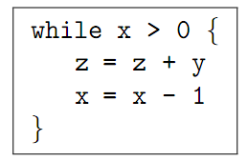
Multiplication
Can be implemented with iterative addition:
Can be done with a “decrement” and a “copy” operation.

Slide 30
Multiplication
START
X > 0
FALSE
STOP
TRUE
Decrement X
Copy Y to Z

Slide 31
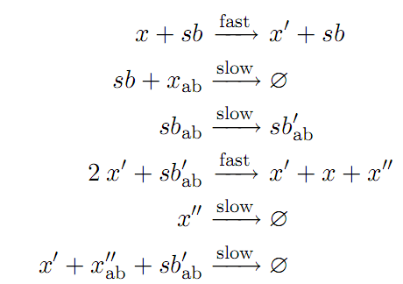
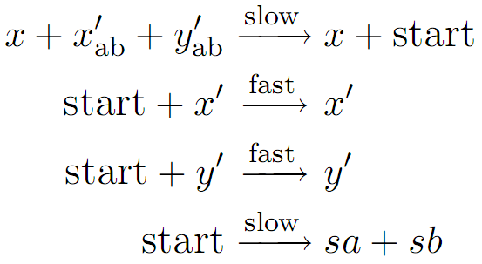
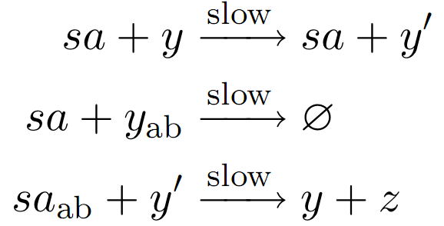
Multiplication

Slide 32
Multiplication
Trial | Fast : Slow | Trajectories | x | y | z | Expected z | Rel. Error
1 | 100 | 100 | 100 | 50 | 4954.35 | 5000 | 0.91%
2 | 100 | 100 | 50 | 100 | 4893.18 | 5000 | 2.14%
3 | 1000 | 100 | 100 | 50 | 4991.56 | 5000 | 0.17%
4 | 1000 | 100 | 50 | 100 | 4995.78 | 5000 | 0.08%
5 | 10000 | 100 | 100 | 50 | 4998.69 | 5000 | 0.03%
6 | 10000 | 100 | 50 | 100 | 4999.14 | 5000 | 0.02%
7 | 10000 | 100 | 10 | 20 | 200.04 | 200 | 0.02%
8 | 10000 | 100 | 20 | 10 | 200.03 | 200 | 0.02%

Slide 33
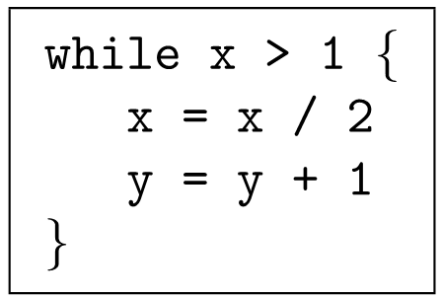
Logarithm

Slide 34
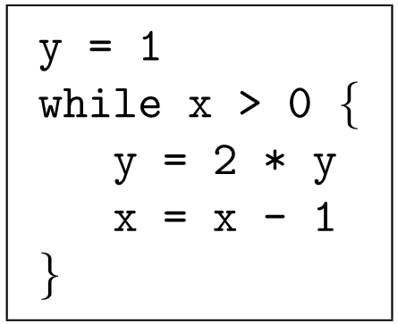
Exponentiation

Slide 35
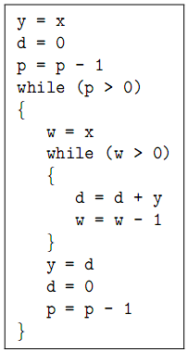
Raise to a Power

Slide 36
Defining a System
Definition by a simple pseudo-code:
  Assignments
  Addition and subtraction
    Constants
    Variables
  “If” and “While”
    Nesting is okay

Slide 37
Future Research
Build a compiler to translate pseudo-code into chemical reaction set.
Implementation via DNA strand displacement
  Soloveichik D, Seelig G, Winfree E (2010) DNA as a universal substrate for chemical kinetics. Proceedings of the National Academy of Sciences 107: 5393-5398.

Slide 38
…
3*
2*
a
1*
3*
…
1
2
3
…
b

Slide 39
waste
…
3*
1*
2*
3*
…
1
2
3
…
c

Slide 40
Acknowledgements
Collaborators:
  Marc Riedel
  Sasha Kharam
  Hua Jiang
Financial Support:
  University of Minnesota
  National Science Foundation
  National Library of Medicine/NIH
PSB organizers

