Slide 1
EE1301: Intro. to Computing Systems
The students will learn the fundamentals of computer science including:
Browsing the “World Wide Web” with Microsoft Explorer™
File management Microsoft Windows Operating System™
Writing documents with Microsoft Word™
Preparing presentations with Microsoft Powerpoint™
Operating on spreadsheets with Microsoft Excel™
Reading and composing electronic mail, “e-mail,” with Microsoft Outlook™

Slide 2
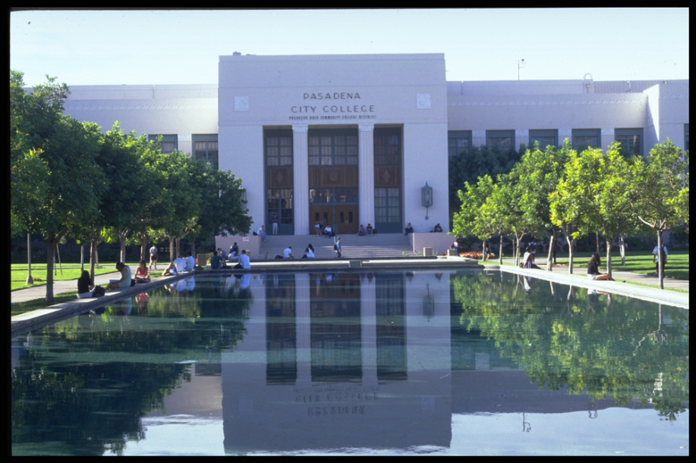
CIS 106: Intro. to Computer Science
EE1301: Intro. to Computing Systems
at Pasadena City College

Slide 3
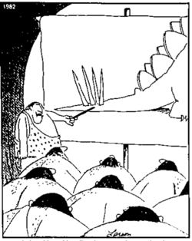
Concepts vs. Jargon
“Now this end is called the thagomizer, after the late Thag Simmons.”

Slide 4
Vertical Slice of Computer Engineering
Quantum Physics (what’s an atom?)
Material Science (why does doped silicon behave as a semiconductor?)
Device Physics (how does a transistor work?)
Circuits (how do we put transistors together to get simple logic functions?)
Logic Design (how do we get complicated logic functions from simpler ones?)
Computer Architecture (how do we build a computer from logic functions?)
Assembly Programming (how do we specify tasks in the form of instructions for the computer?)
High-Level Programming (how do we specify tasks in a form that can be translated into instructions for the computer?)

Slide 5
Vertical Slice of Computer Engineering
Quantum Physics (what’s an atom?)
Material Science (why does doped silicon behave as a semiconductor?)
Device Physics (how does a transistor work?)
Circuits (how do we put transistors together to get simple logic functions?)
Logic Design (how do we get complicated logic functions from simpler ones?)
Computer Architecture (how do we build a computer from logic functions?)
Assembly Programming (how do we specify tasks in the form of instructions for the computer?)
High-Level Programming (how do we specify tasks in a form that can be translated into instructions for the computer?)
EE1301
CS 1901 & CS1902

Slide 6
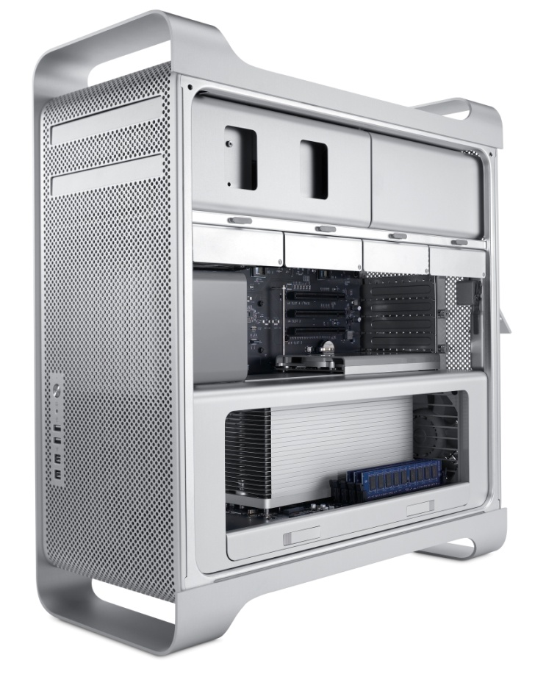
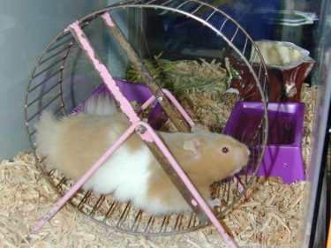
No Hamsters, No Magic
Any sufficiently advanced technology is indistinguishable from magic.
– Arthur C. Clarke

Slide 7
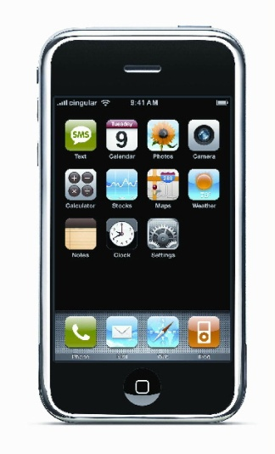

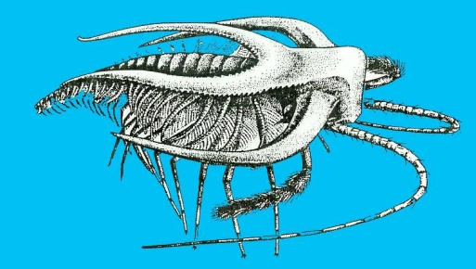
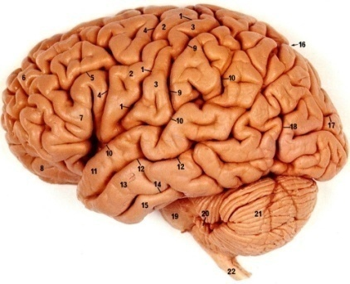
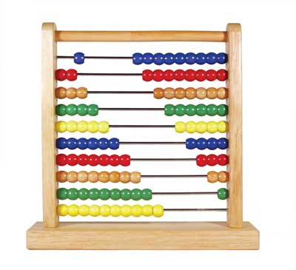
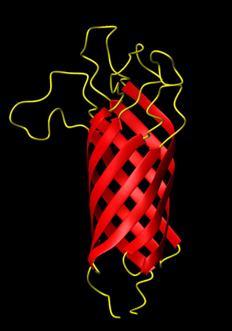
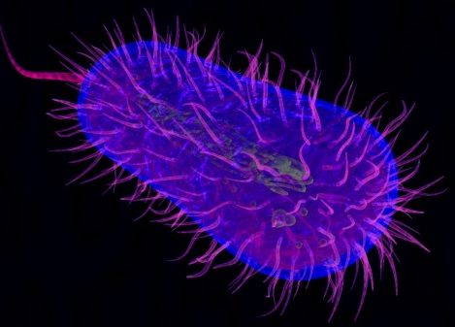
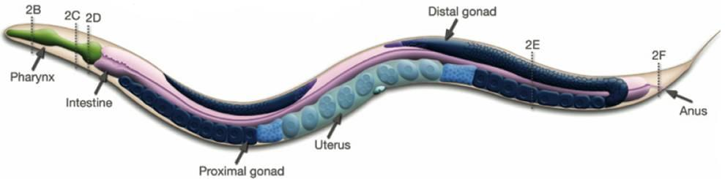
Examples of Computing Systems
Are all these systems “equivalent”?

Slide 8
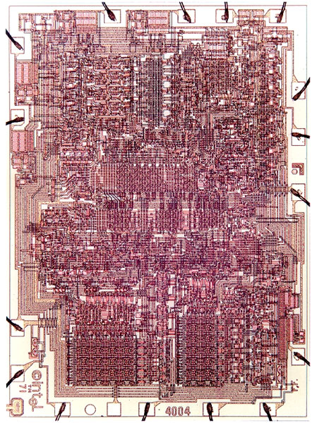
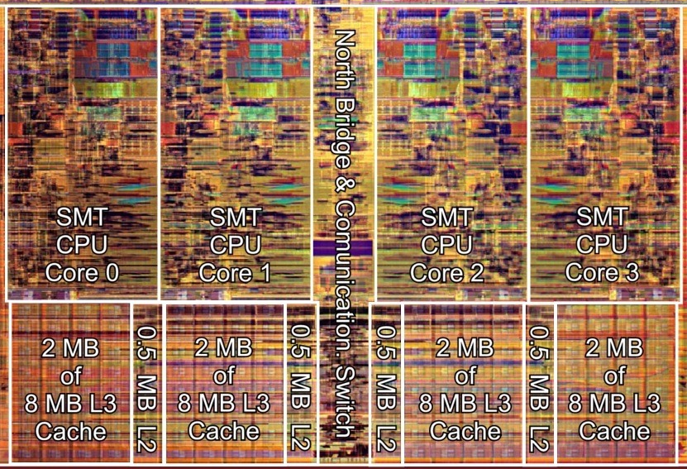
Building Digital Circuits
Intel 4004 (1971)
~2000 gates
Intel “Nehalem” (2008)
~2 billion gates

Slide 9
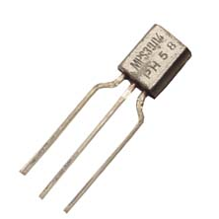
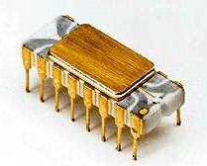
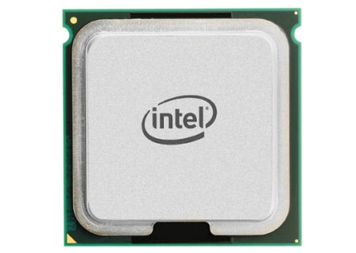
Boxes inside Boxes [inside boxes…]
1 transistor (1960’s)
2000 transistors (Intel 4004, 1971)
2 billion transistors (Intel Chip, 2013)
Notes:
Heady Times.

Slide 10
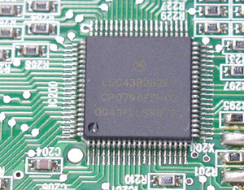


Integrated Circuits
inputs
outputs
0
1
1
0
circuit
1
1
0
$$⋮$$
$$⋮$$
0
1
What do integrated circuits do?
accept zeros and ones as inputs;
produce zeros and ones as outputs.

Slide 11
Integrated Circuits
inputs
outputs
0
1
1
0
circuit
1
1
0
$$⋮$$
$$⋮$$
0
1
Why do we want this?
zeros and ones represent information;
circuit performs computation.

Slide 12
Integrated Circuits
inputs
outputs
0
1
1
0
circuit
1
1
0
$$⋮$$
$$⋮$$
0
1
How do we build (design) such circuits?
hierarchically, from components.

Slide 13
All (or mostly) About “Bits”
0
1
zero
one
false
true
off
on
open
closed
not asserted
asserted
not set
set
…
…

Slide 14

Truth Tables
Example
x₁
x₂
x₃
f
m variables
2^{m} rows
0
0
0
0
0
0
1
0
2 variables
4 rows
0
1
0
0
3 variables
8 rows
0
1
1
1
1
0
0
0
$$⋮$$
$$⋮$$
1
0
1
1
64 variables
2⁶⁴ rows
1
1
0
0
1
1
1
1

Slide 15
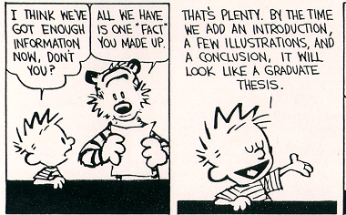

Slide 16
Logic Gates
Common Gate:
“AND” gate
0
0
0
0
1
0
1
0
0
1
1
1
Notes:
Generally thought of as acyclic structures (often defined as a DAG).
Once input values are applied, values propagate to the outputs.
Outputs assume definite boolean values regardless of the initial values on the wires and independently of all timing assumptions.

Slide 17
Logic Gates
Common Gate:
“OR” gate
0
0
0
0
1
1
1
0
1
1
1
1
Notes:
Generally thought of as acyclic structures (often defined as a DAG).
Once input values are applied, values propagate to the outputs.
Outputs assume definite boolean values regardless of the initial values on the wires and independently of all timing assumptions.

Slide 18
Logic Gates
Common Gate:
“NAND” gate
0
0
1
0
1
1
1
0
1
1
1
0
Notes:
Generally thought of as acyclic structures (often defined as a DAG).
Once input values are applied, values propagate to the outputs.
Outputs assume definite boolean values regardless of the initial values on the wires and independently of all timing assumptions.

Slide 19
Logic Gates
Common Gate:
“NOR” gate
0
0
1
0
1
0
1
0
0
1
1
0
Notes:
Generally thought of as acyclic structures (often defined as a DAG).
Once input values are applied, values propagate to the outputs.
Outputs assume definite boolean values regardless of the initial values on the wires and independently of all timing assumptions.

Slide 20
Logic Gates
Common Gate:
“XOR” gate
0
0
0
0
1
1
1
0
1
1
1
0
Notes:
Generally thought of as acyclic structures (often defined as a DAG).
Once input values are applied, values propagate to the outputs.
Outputs assume definite boolean values regardless of the initial values on the wires and independently of all timing assumptions.

Slide 21
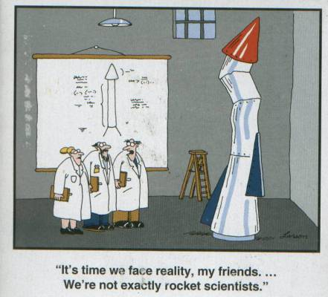

Slide 22
A Computing System…

Slide 23
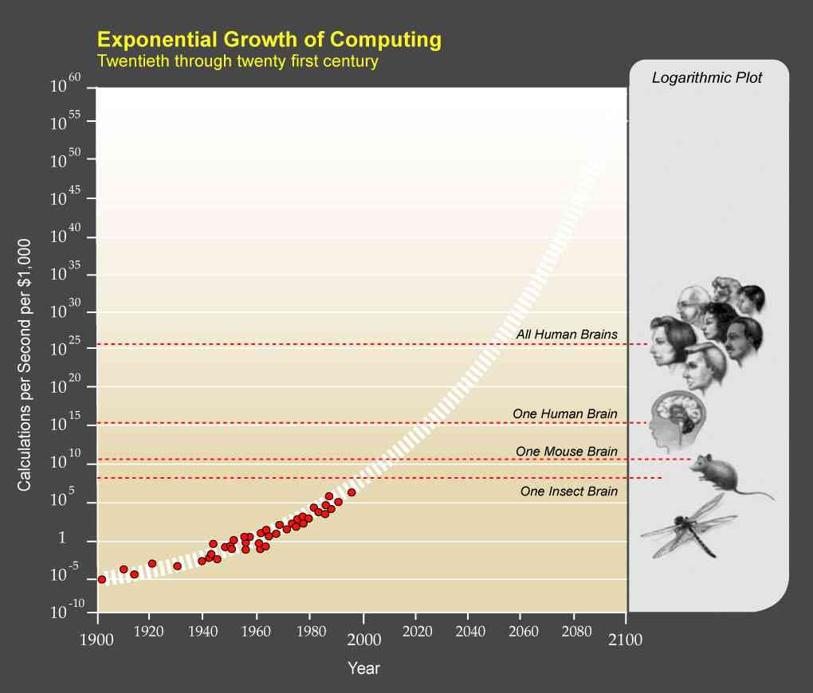
Technology and Society

Slide 24
Astonishing Hypothesis
“A person's mental activities are entirely due to the behavior of nerve cells, glial cells, and the atoms, ions, and molecules that make them up and influence them.”
– Francis Crick, 1982
The Astonishing Part:
“That the astonishing hypothesis is astonishing.”
– Christophe Koch, 1995

Slide 25
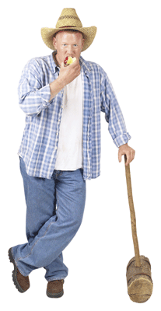
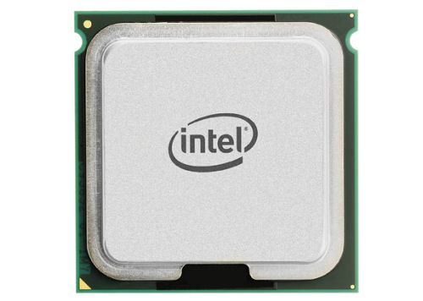
Domains of Expertise
Vision
Language
Abstract Reasoning
Farming
Circuit
Number Crunching
Mining Data
Iterative Calculations
Human

Slide 26
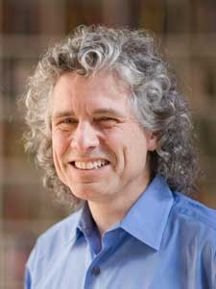

Language as a Window into the way the Brain Works
Steven Pinker, Harvard

Slide 27
Circuits & Computers as a Window into our Linguistic Brains
Brain
Circuit
Conceives of circuits and computation by “applying” language.
?
Lousy at all the tasks that the brain that designed it is good at (including language).

