Slide 1

A Deterministic Approach to Stochastic Computation
Devon Jenson and Marc Riedel
University of Minnesota
ICCAD – November 9th, 2016
<
1,1,1,1,0…
x₁
<
1,0,0,0,1…
x₂

Slide 2
Summary
Randomness is not a requirement for stochastic computing
Deterministic bit streams
Same benefits
Reduce latency by an exponential factor
Compute with perfect precision
Reduce gate count by at least 40%

Slide 3
Overview
Background: Stochastic Computation
Average View of Stochastic Computation
Deterministic Methods and Circuits
Experimental Results
Conclusion and Future Work

Slide 4
Stochastic Computation
  Advocated by Gaines¹ and Poppelbaum²
  Random bit streams are used to represent values in the range 0 ≤ x ≤ 1
  Each value is the probability that the bit stream will be ‘1’
Fractional uniform encoding
x = 0.3 = 3/10
0,1,0,0,1,0,1,0,0,0
Gaines, B.R. (1967) Stochastic computing. AFIPS Conf. Proc. 30, 149-156
Poppelbaum, W.J., Afuso, C., and Esch, J. W. (1967). Stochastic computing elements and systems. AFIPS, Proc. FJCC, 30, 149-156

Slide 5
Stochastic Computation
Logical computation on random bit streams.
0,1,1,0,1,0,1,0,…
0,1,1,0,1,0,0,0,…
logic
circuit
1,1,0,1,0,1,1,0…
1,0,1,0,1,0,1,0,…
1,0,0,0,1,1,0,0,…
1,1,1,1,1,1,1,1,…

Slide 6
Stochastic Computation
Logical computation on random bit streams.
4/8
logic
circuit
5/8
3/8
combinational
circuit
4/8
3/8
8/8
Probability values are the input and output signals.

Slide 7
Arithmetic Operations
Multiplication
(Scaled) Addition
A
1
A
C
C
B
B
0
S
c = P(C)
c = P(C)
= P(A)P(B)
= P(S)P(A)+[1-P(S)]P(B)
= ab
= sa+(1-s)b

Slide 8



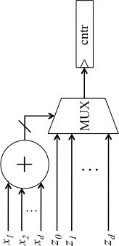
Arithmetic Operations
  Arbitrary polynomial functions^{3,4}
Gamma Correction
Function
3. Weikang Qian and M. D. Riedel, "The synthesis of robust polynomial arithmetic with stochastic logic," DAC, 2008.
4. N. Saraf and K. Bazargan, "Polynomial arithmetic using sequential stochastic logic,” GLSVLSI, 2016.

Slide 9
Caveman Analogy
  Analogy: primitive form of computation
  Relies on randomness to simplify circuitry
p_{A} = 1/2
p_{B} = 2/3

Slide 10
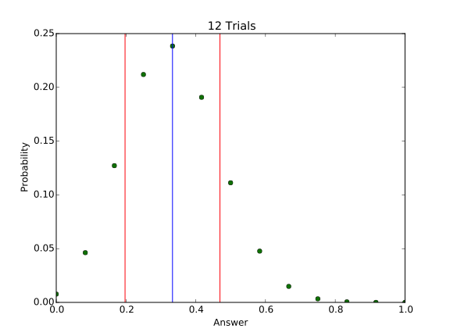
Caveman Analogy
Error is likely within 42%

Slide 11
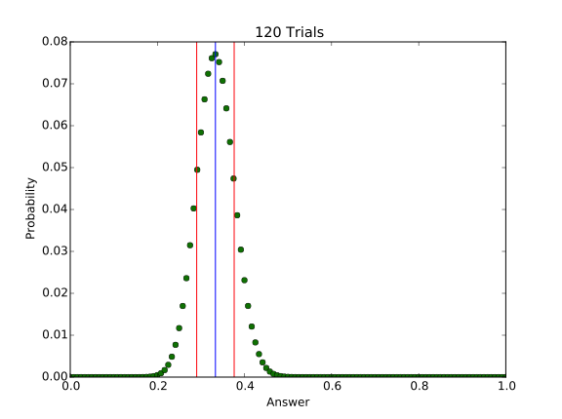
Caveman Analogy
Error is likely within 14%

Slide 12
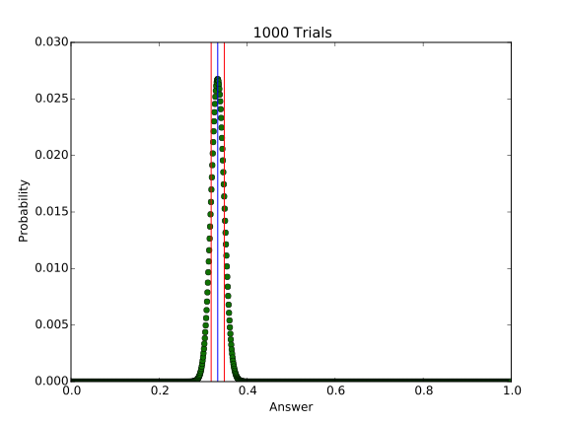
Caveman Analogy
Error is likely within 5%

Slide 13
Precision
  Impossible to guarantee a certain level of precision
  ~2/3 of the time the error is bound by:
  For a typical precision of B binary bits:

Slide 14
Precision
  For typical 8 binary bits of precision:
  Bounds are only valid ~2/3 of the time
  Limited to applications where long latency and approximate calculations are acceptable

Slide 15
Accuracy
  Correlation between inputs results in the output converging to a bias from the correct answer
  LFSRs chosen over physical noise sources

Slide 16
Generation
  Randomizer unit [3]: binary to pseudo-random bit stream
L-bit
<
010..1101
C
  Length of bit stream depends on LFSR length

Slide 17
Generation
8-bit
<
10000…10100
C

Slide 18
Generation
16-bit
8-bit
<
C₁
16-bit
8-bit
<
C₂
  Length of LFSRs depend on output resolution

Slide 19
Stochastic Computation
Pros | Cons
Simple Arithmetic Logic | Long Latency
 | Approximate Answers
  Avoiding correlation requires expensive hardware
  Relying on randomness is more trouble than it worth

Slide 20
Taking a Look at the Average
View the streams on average
Example:

Slide 21
Taking a Look at the Average

Slide 22
Taking a Look at the Average
Independent:
P[A|B] = P[A], P[B|A] = P[B]
1
1 0 0
1 0 0
1 0 0
P[A] = 1/3
0
0
P[A] = 1/3
P[B] = 2/3
1 1 0
0
P[B] = 2/3
1
1
1 1 0
1 1 0
  On average, each outcome of one bit stream will see the average value of the other bit stream

Slide 23
Taking a Look at the Average
By using independent random bit streams, the average bit streams are “pre-convolved”
101
110
110
110
110
110
110
110
10
00
11
10
01
11
11
01
11

Slide 24
Taking a Look at the Average
Analogy: outer product

Slide 25
Taking a Look at the Average
In general, the function implemented by an arbitrary logic gate is given by:
☐
where ☐ is an arbitrary logic operator
Independent random bit streams
Pre-convolving the average bit streams

Slide 26
Deterministic Approach
p_{X} = 1/3
p_{Y} = 2/3
= 100
= 110
100 100 100
111 111 000
100 100 100
X
100 100 000
111 111 000
Z
Y
p_{Z} = p_{X} p_{Y} = 2/9

Slide 27
Deterministic Approach
p_{X} = 1/3
p_{Y} = 2/3
= 100
= 110
100 100 100
111 111 000
100 100 100
X
111 111 100
111 111 000
Z
Y
p_{Z} = p_{X} + p_{Y} – p_{X} p_{Y} = 7/9

Slide 28
Deterministic Approach
p_{A} = 1/2
p_{B} = 2/3
p_{A}p_{B} = 2/6

Slide 29
Precision
  For B binary bits of precision:
Deterministic
Stochastic
guaranteed
~2/3 of the time
  Deterministic approach:
    Exponential reduction in latency
    Guaranteed precision
    Same simple arithmetic logic

Slide 30
Deterministic Methods
Three methods:
  Relatively Prime Stream Lengths
  Rotation
  Clock Division
Number Source
[0, 2^{n})
Q
n-bit
Comparator
G = Q < C
G
Constant Number
[0, 2^{n})
C

Slide 31
Deterministic Methods
G_{i-1}
Converter
Module
C_{i-1}
…0,1,1,1,0,1,1,1,0,1…
i -1
. . .
Interconnect
G₁
Converter
Module
C₁
...0,0,0,0,1,1,1,1,0,0…
1
Interconnect
G₀
Converter
Module
C₀
...0,1,1,1,0,1,1,1,0,1…
0

Slide 32
Deterministic Methods
A
AB
B
ABC ∨ABD
C
C ∨D
D

Slide 33
Relatively Prime Stream Lengths
[0, 3)
A
[0, 12)
[0, 4)
B
[0, 60)
[0, 5)
C

Slide 34
Relatively Prime Circuit
CLK
. . . .
Cntr
[0, R₀)
Cntr
[0, R₁)
Cntr
[0, R₂)
C₀
Q₀
C₁
Q₁
C₂
Q₂
Comp
Comp
Comp
G₀
G₁
G₂
n counters, n comparators

Slide 35
Rotation
repeat: 4
A
repeat: 16
rotate: 4
B
repeat: 256
rotate: 16
C

Slide 36
Rotation Circuit
CLK
Cntr
[0, 2^{n})
Cntr
[0, 2^{n})
. . . .
Inhibit
Inhibit
Cntr
[0, 2^{n})
Cntr
[0, 2^{n})
Cntr
[0, 2^{n})
. . . .
C₀
Q₀
C₁
Q₁
C₂
Q₂
Comp
Comp
Comp
G₀
G₁
G₂
2n-1 counters, n comparators

Slide 37
Clock Divide
repeat: 4
A
repeat: 16
divide: 4
B
repeat: 256
divide: 16
C

Slide 38
Clock Divide Circuit
CLK
Cntr
[0, 2^{n})
Cntr
[0, 2^{n})
Cntr
[0, 2^{n})
…
C₀
Q₀
C₁
Q₁
C₂
Q₂
Comp
Comp
Comp
G₀
G₁
G₂
n counters, n comparators

Slide 39
Comparison
<
1,1,1…
<
1,1,1…
x₁
x₁
<
1,0,0…
<
1,0,0…
x₂
x₂
Representation | Method | Gates
Stochastic | Randomizer | 12ni²+3ni
Deterministic | Rel. Prime | 9ni
 | Rotation | 15ni-6n
 | Clock Div. | 9ni
reduction in gates ≥ 40%

Slide 40
Conclusion
  There is no clear reason to rely on randomness when deterministic bit streams can perform the same computation:
in exponentially less time
with perfect precision
with less logic

Slide 41
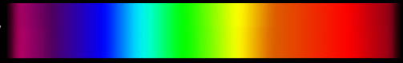
Future Work
Addition, subtraction, and division
Constant precision
Spectrum of encodings
Binary Radix Encoding
(Compact, Positional)
?
Stochastic Encoding
(Not compact, Uniform)

Slide 42
Thank you!

