Slide 1
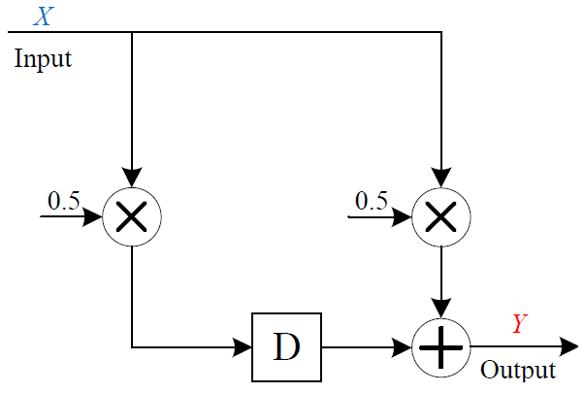
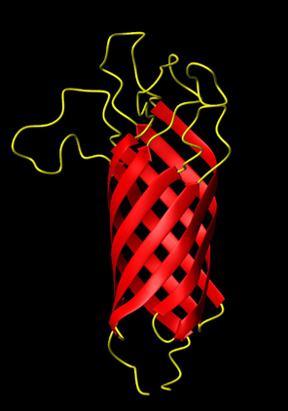
Digital Signal Processing with Biomolecular Reactions
Hua Jiang, Aleksandra Kharam, Marc Riedel, and Keshab Parhi
Electrical and Computer Engineering
University of Minnesota
Notes:
1
Say sth at this opening slide

Slide 2
Overview
  Signal processing with chemical reactions: exact and rate-independent designs.
  Technology-independent designs: abstract chemical reactions.
  Technology-mapping: DNA strand displacement reactions.
  Examples: FIR moving average and IIR biquad filters.
  General synthesis methdology.
Notes:
Color-code this slide

Slide 3
Digital Signal Processing
A digital signal processing (DSP) system takes an input sequence and produces an output sequence.
A digital signal is a sequence of numbers.
1010
0010
1100
0101
0110
0111
Electronics
Chemical
Reactions
input
DSP
output
10, 2, 12, 8, 4, 8, 10, 2, …
Chemically, molecular quantities, or concentrations, represent the digital signal.
Electronically, numbers are represented by binary strings (zeros and ones are voltages).
5, 6, 7, 10, 6, 6, 9, 6, …
Notes:
Emphasize on “Concentration”

Slide 4

Playing by The Rules
Biochemical Reactions:
rules specifying how types of molecules combine.
k
a
+
+
b
c
  Modeled by ordinary differential equations (ODEs)
Notes:
Take time explaining
ASYNCHRONOUSLY!!! And in parallel

Slide 5
DSP with Reactions
Input
Output
10, 2, 12, 8, 4, 8, 10, 2, …
5, 6, 7, 10, 6, 6, 9, 6, …
Reactions
…
…
Time-varying changes in concentrations of an input molecular type.
Time-varying changes in concentrations of output molecular type.

Slide 6
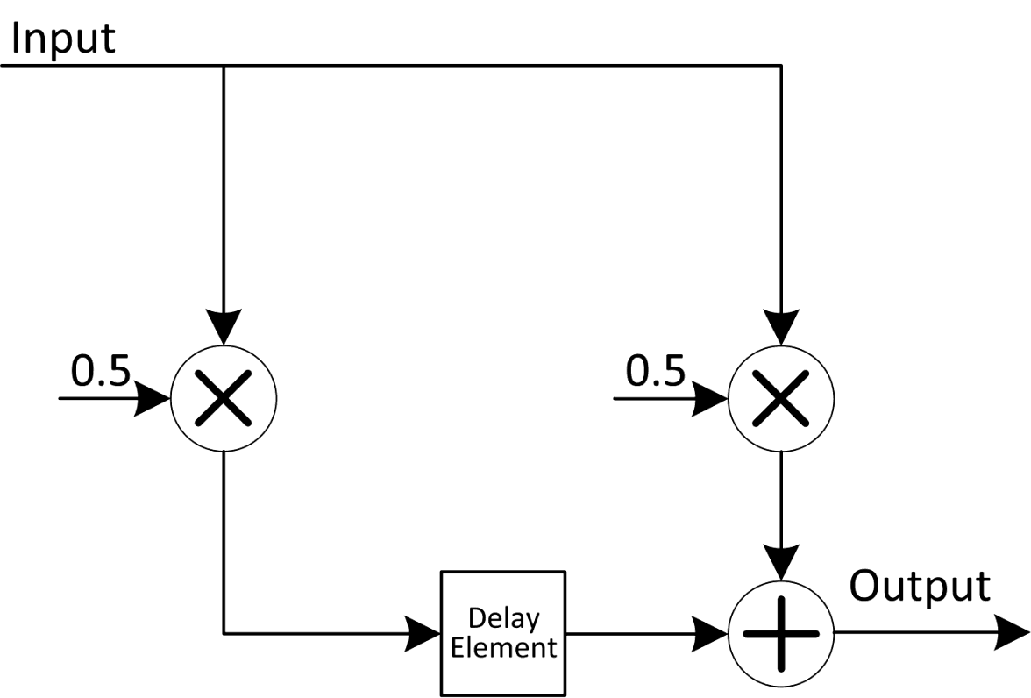

Moving Average Filter: Chemical
Chemical
Reactions
time
time
But how do we achieve the synchronization?
Notes:
Say synchronization. Put y[n]=.5x[n-1]+.5[n]

Slide 7
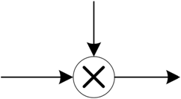
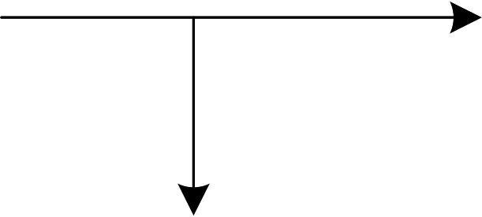
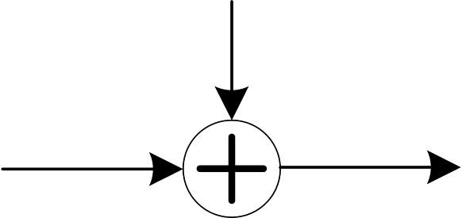
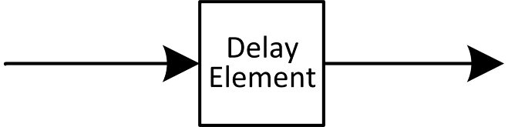
DSP Building Blocks
Most DSP systems can be specified in terms of 4 major components: constant multipliers, fanouts, adders and delay elements.
Constant Multiplier
Fanout
Adder
Delay Element

Slide 8


Computational Modules
Constant Multiplier
X
Y

Slide 9

Computational Modules
Adder
Notes:
No SPECIFIC ANYTHING

Slide 10


Computational Modules
X
Fanout
B
A

Slide 11

Delay Element
Molecular quantities are preserved over “computational cycles.” Contents of different delay elements are transferred synchronously.

Slide 12
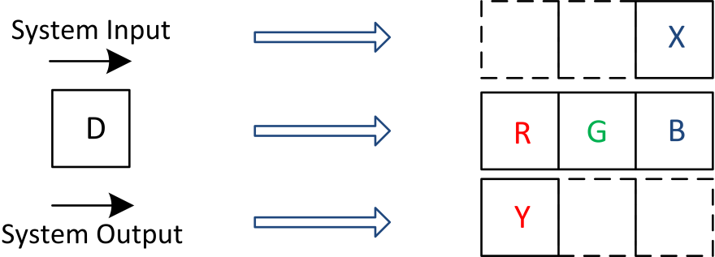

3-Phase Scheme
We use a three compartment configuration for delay elements: we categorize the types into three groups: red, green and blue.
Every delay element D_{i} is assigned R_{i}, G_{i}, and B_{i}
Notes:
Why fire to completion/subscripts

Slide 13
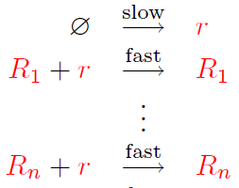

Absence Indicators
But how do we know that a
group of molecules is absent?
R
r
Notes:
Say sth about \phi / animation speed

Slide 14
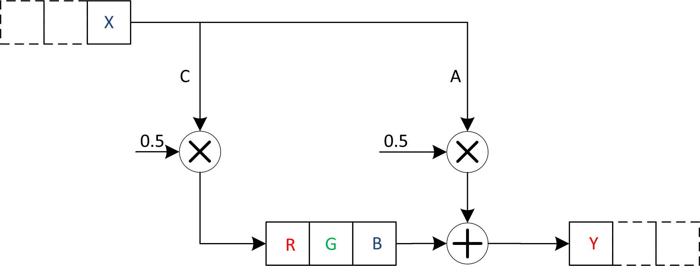
Moving Average Filter
absence
indicators

Slide 15
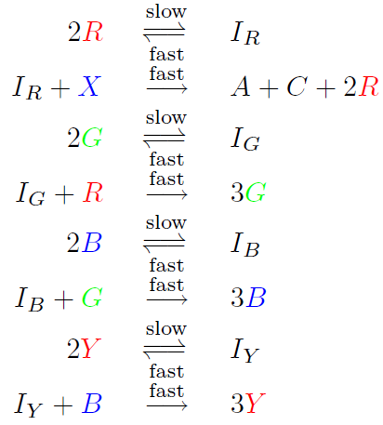

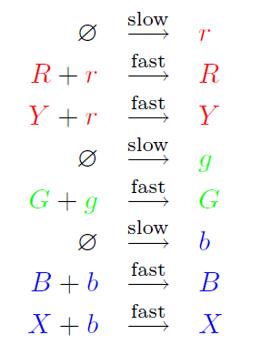

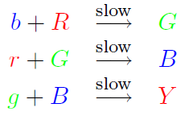
Moving Average Filter
Signal transfer
Computation
Absence indicator
Notes:
Use reversible reactions/ color coding RGBXY / boxing X and Y

Slide 16
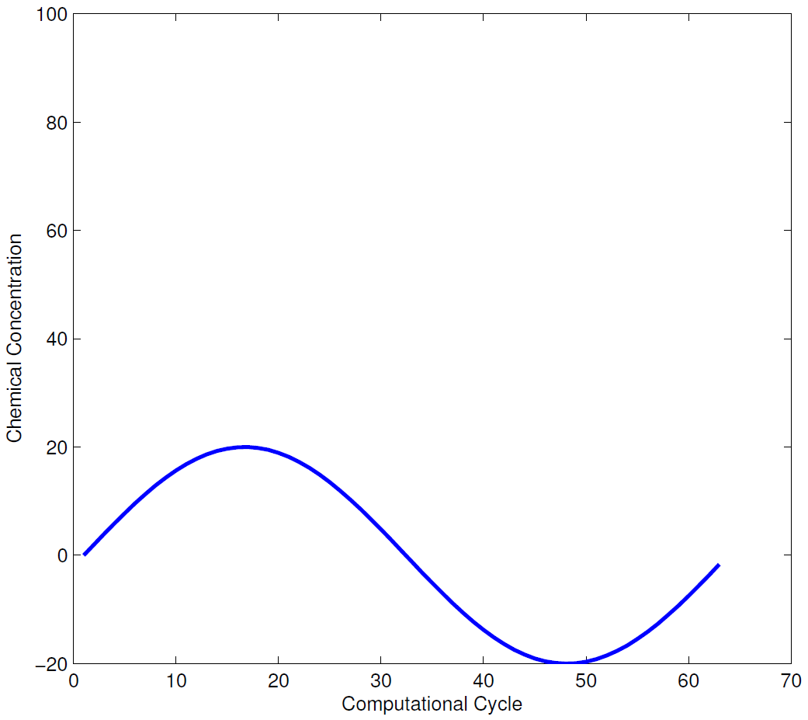
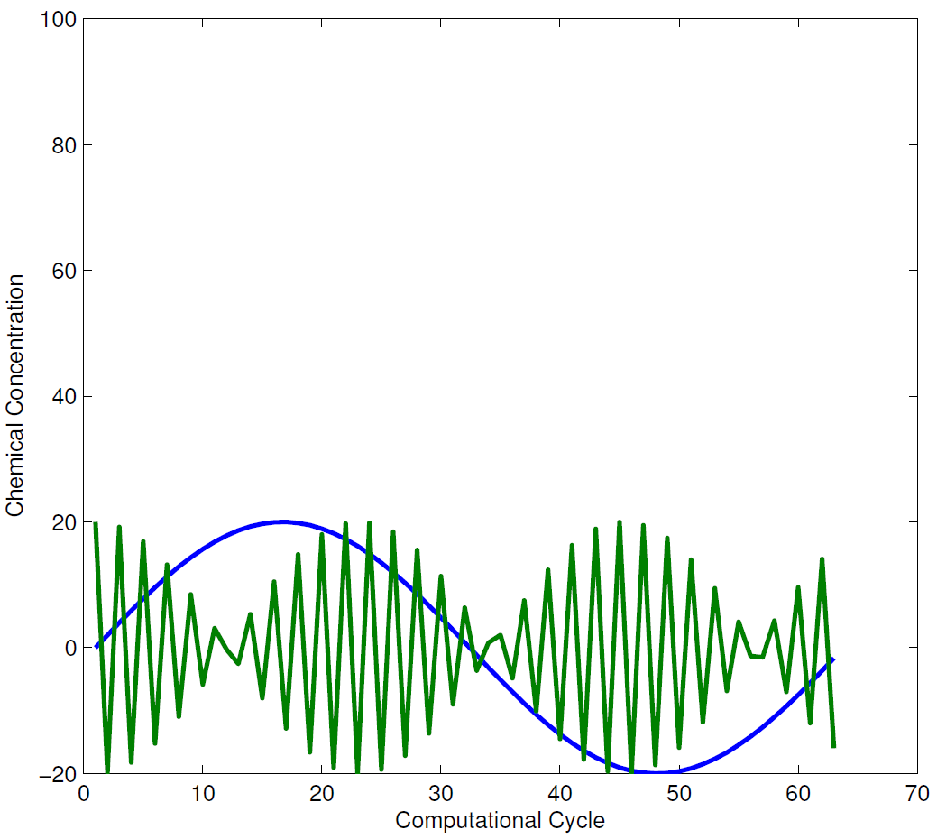
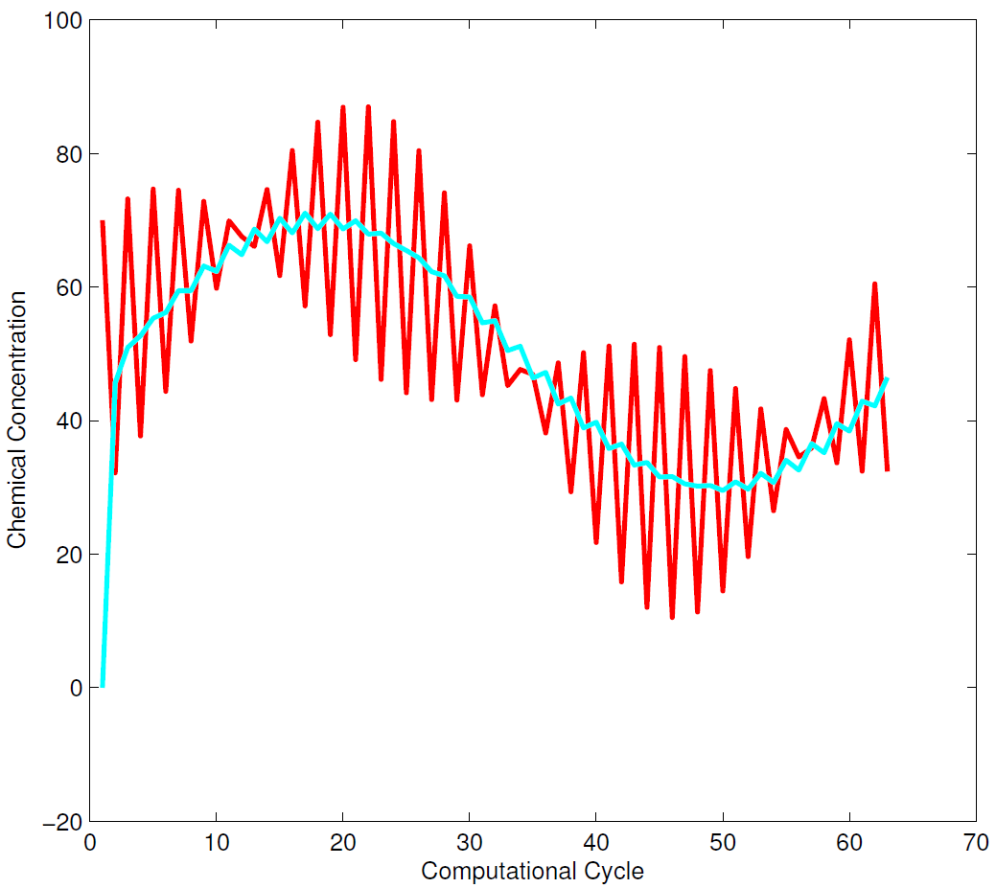
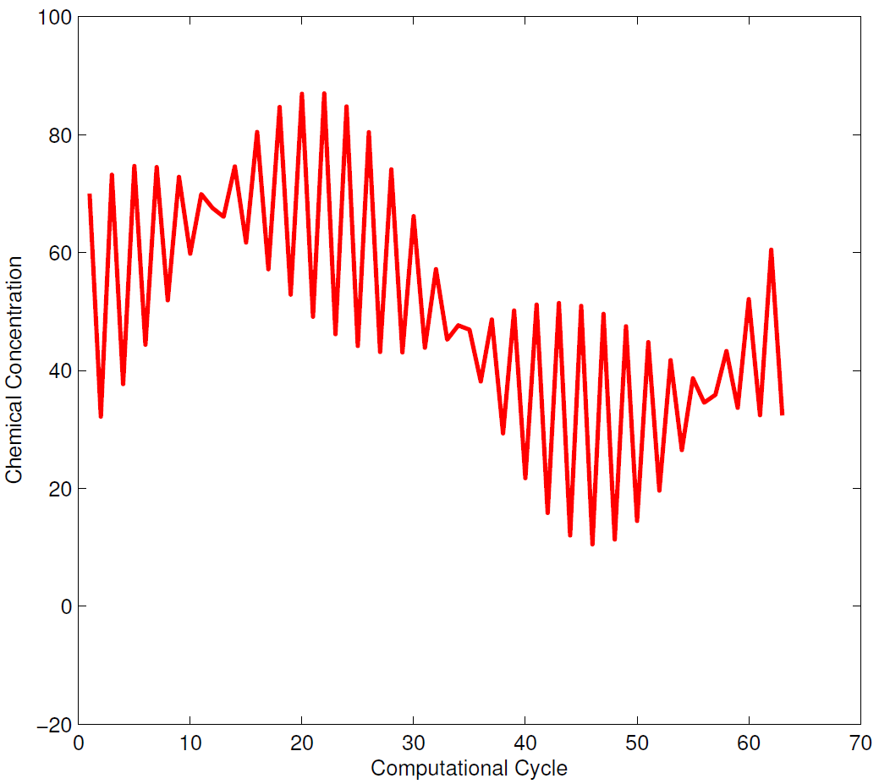
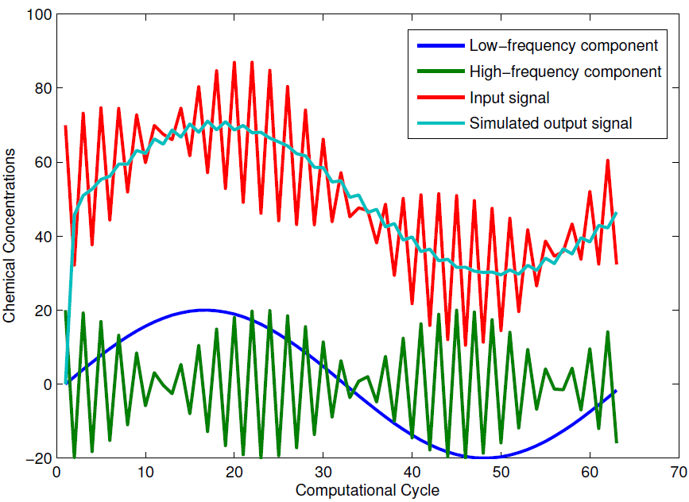
Simulation Results: Moving Average
Output obtained by ODE simulations of the chemical kinetics.

Slide 17
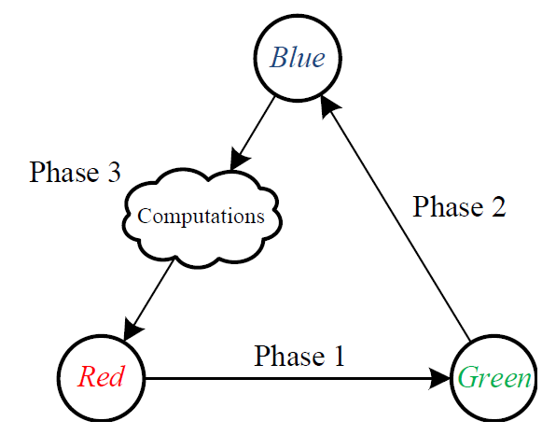
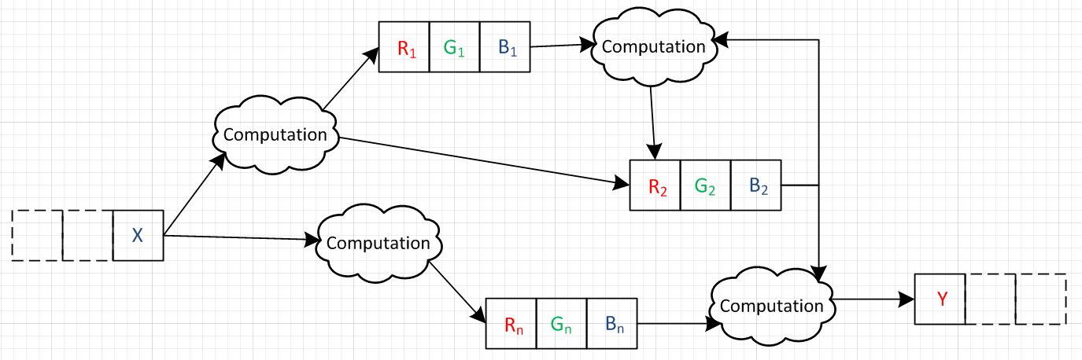
General DSP System

Slide 18
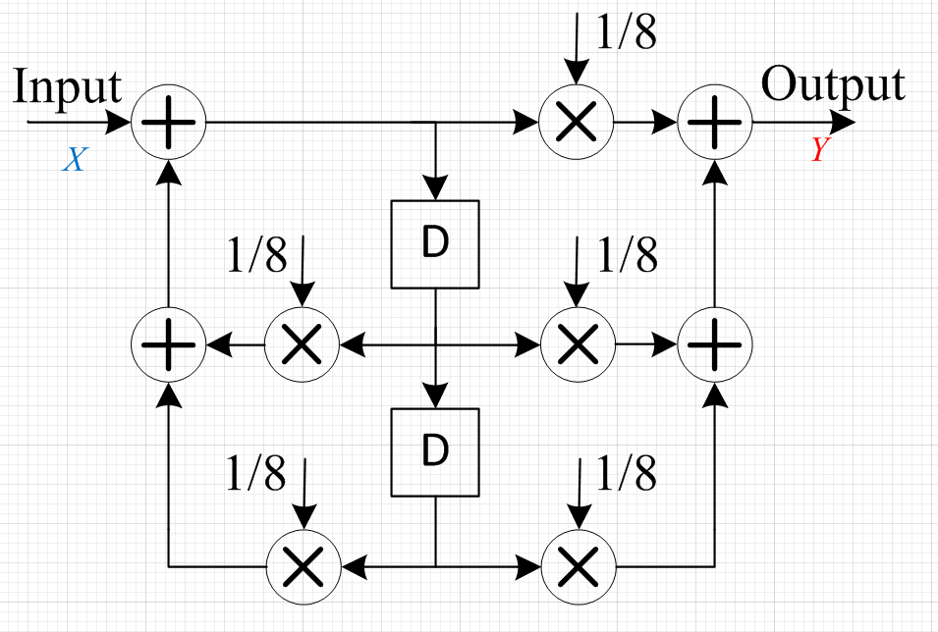
Biquad Filter

Slide 19
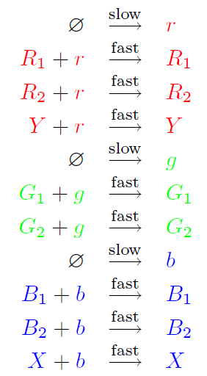
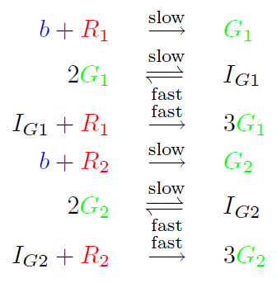
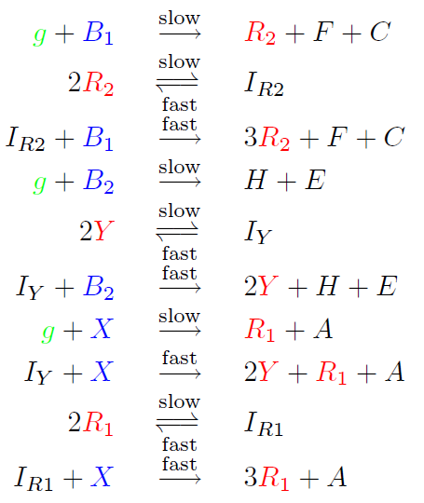
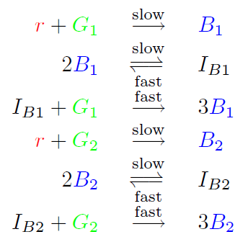
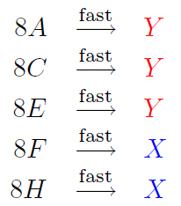
Biquad Filter
Absence indicator
Signal transfer
Computation

Slide 20
Discussion
Computational Chemical Design
vis-a-vis
Technology-Independent Logic Synthesis
Synthesize a design for a precise, robust, programmable computation – with abstract types and reactions.
Experimental Design
vis-a-vis
Technology Mapping in Circuit Design
Implement design by selecting specific types and reactions – say from “toolkit”.

Slide 21
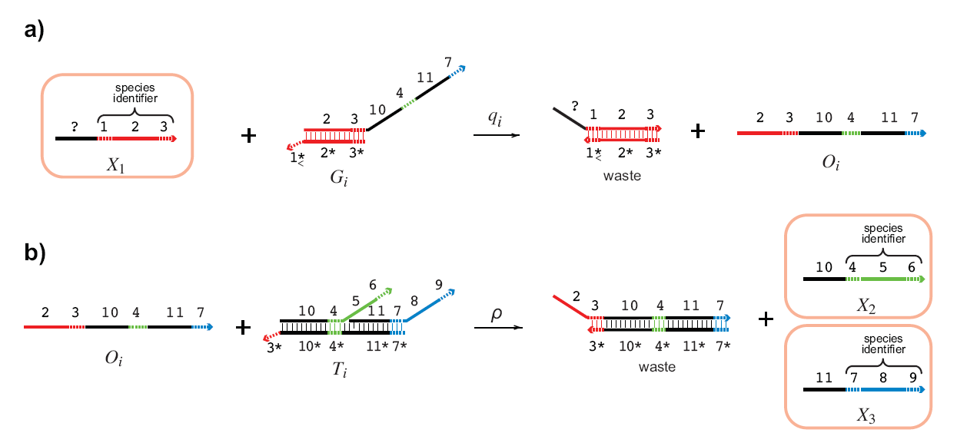
Technology Mapping:
DNA Strand Displacement
X₁
X₂
+
X₃
D. Soloveichik et al: “DNA as a Universal Substrate for Chemical Kinetics.” PNAS, Mar 2010

Slide 22
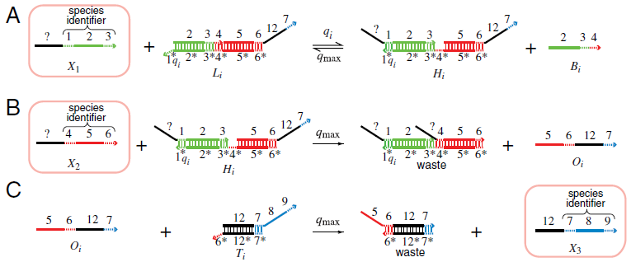
Technology Mapping:
DNA Strand Displacement
X₁
+
X₂
X₃
D. Soloveichik et al: “DNA as a Universal Substrate for Chemical Kinetics.” PNAS, Mar 2010

Slide 23
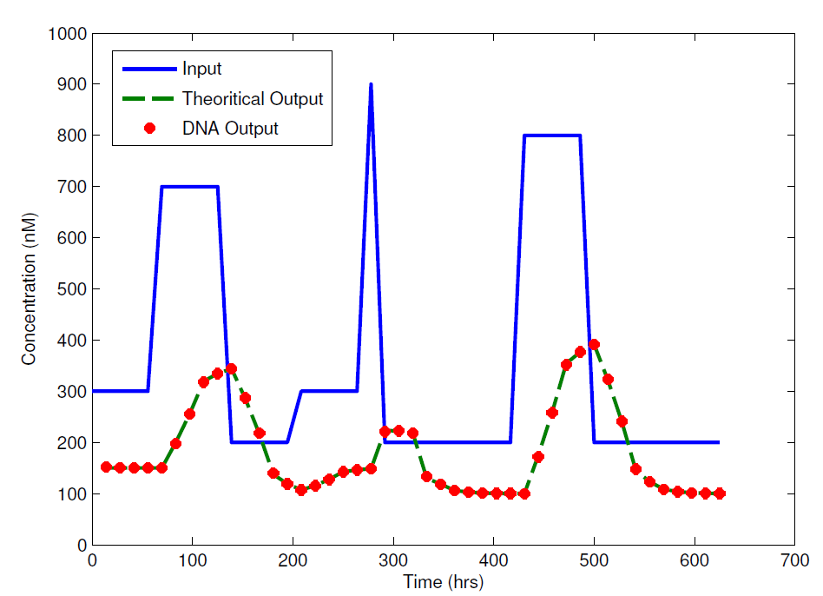
Simulation Results: Biquad Filter
Output obtained by ODE simulations of chemical kinetics at the DNA level.
Notes:
Say/list sth further

Slide 24
Conclusions
Functionality:
  Basic digital signal are implemented with chemical reactions.
Robustness:
  Computation is rate independent. Implementation requires only coarse rate levels.
  An automatic compiler is available at http://cctbio.ece.umn.edu/biocompiler
Notes:
Add one more bullet

Slide 25
Future Work
Experimental Implementation and Optimization
  Translate into DNA strand displacement reactions.
  Optimization reactions at the DNA level.
System performance analysis
  Dynamic range
  Precision
  Representation of negative signals
Applications
  Drug delivery.
  Biochemical sensing.

Slide 26


Questions?
Thanks to NSF and BICB
Biomedical Informatics & Computational Biology
UMN / Mayo Clinic / IBM
NSF CAREER Award #0845650
NSF EAGER Grant #0946601

